Slide 1
Structured Analysis and Design

Slide 2
Introduction
Structured analysis is a modelling technique:
  DFD (Data Flow Diagram) is the modelling technique used
  Functional requirements are modelled.
Why model functionalities?
  Used for functional requirements exploration and validation
  A starting point for design.

Slide 3
Introduction
Two distinct style of design:
  Function-oriented or Procedural
    Top-down approach
    Carried out using Structured analysis and structured design
    Coded using languages such as C
  Object-oriented
    Bottom-up approach
    Carried out using UML
    Coded using languages such as Java, C++, C#

Slide 4
Structured analysis and Structured Design
During Structured analysis:
  High-level functions are successively decomposed:
    Into more detailed functions.
During Structured design
  The detailed functions are mapped to a module structure.

Slide 5
Structured Analysis
Successive decomposition of high-level functions:
  Into more detailed functions.
  Technically known as top-down decomposition.

Slide 6
SA/SD (Structured Analysis/Structured Design)
SA/SD technique draws heavily from the following methodologies:
  Constantine and Yourdon's methodology
  Hatley and Pirbhai's methodology
  Gane and Sarson's methodology
  DeMarco and Yourdon's methodology
SA/SD technique can be used to perform
  high-level design.

Slide 7
Functional Decomposition
Each function is analyzed:
  Hierarchically decomposed into more detailed functions.
  Simultaneous decomposition of high-level data
    Into more detailed data.

Slide 8
Structured Analysis
Textual problem description converted into a graphic model.
  Done using data flow diagrams (DFDs).
  DFD graphically represents the results of structured analysis.

Slide 9
Structured Analysis
The results of structured analysis can be easily understood even by ordinary customers:
  Does not require computer knowledge.
  Directly represents customer’s perception of the problem.
  Uses customer’s terminology for naming different functions and data.
The results of structured analysis can be reviewed by customers:
  To check whether it captures all their requirements.

Slide 10
Structured Design
The functions represented in the DFD:
  Mapped to a module structure.
Module structure:
  Also called software architecture

Slide 11
Structured Analysis vs. Structured Design
Purpose of structured analysis:
  Capture the detailed structure of the system as the user views it.
Purpose of structured design:
  Arrive at a form that is suitable for implementation in some programming language.

Slide 12
Structured Analysis: Recap
Based on principles of:
  Top-down decomposition approach.
  Divide and conquer principle:
    Each function is considered individually (i.e. isolated from other functions).
    Decompose functions totally disregarding what happens in other functions.
  Graphical representation of results using
    Data flow diagrams (or bubble charts).

Slide 13
Data Flow Diagram
DFD is a hierarchical graphical model:
  Shows the different functions (or processes) of the system and
  Data interchange among the processes.
Display-board
0.1
game
move
result
Validate-move
0.2
Check-winner
0.4
board
Play-move
0.3

Slide 14
DFD Concepts
It is useful to consider each function as a processing station:
  Each function consumes some input data.
  Produces some output data.

Slide 15

Data Flow Model of a Car Assembly Unit
Engine Store
Door Store
Partly Assembled Car
Fit
Doors
Paint
and
Test
Fit
Engine
Fit
Wheels
Chassis with Engine
Assembled Car
Car
Chassis Store
Wheel Store

Slide 16
Data Flow Diagrams (DFDs)
A DFD model:
  Uses limited types of symbols.
  Simple set of rules
  Easy to understand --- a hierarchical model.

Slide 17
Hierarchical Model
As pointed out earlier:
  Human cognitive restrictions are overcome through use of a hierarchical model:
  In a hierarchical model:
    We start with a very simple and abstract model of a system,
    Details are slowly introduced through the hierarchies.

Slide 18
A Hierarchical Model

Slide 19
Data Flow Diagrams (DFDs)
Primitive Symbols Used for Constructing DFDs:

Slide 20
External Entity Symbol
Represented by a rectangle
External entities are either users or external systems:
  input data to the system or
  consume data produced by the system.
  Sometimes external entities are called terminator, source, or sink.
Librarian

Slide 21
Function Symbol
A function such as “search-book” is represented using a circle:
  This symbol is called a
  process or bubble or transform.
  Bubbles are annotated with corresponding function names.
  A function represents some activity:
    Function names should be verbs.
search-book

Slide 22
Data Flow Symbol
A directed arc or line.
  Represents data flow in the direction of the arrow.
  Data flow symbols are annotated with names of data they carry.
book-name

Slide 23
Data Store Symbol
Represents a logical file:
  A logical file can be:
    a data structure
    a physical file on disk.
  Each data store is connected to a process:
    By means of a data flow symbol.
book-details

Slide 24
Data Store Symbol
Direction of data flow arrow:
  Shows whether data is being read from or written into it.
An arrow into or out of a data store:
  Implicitly represents the entire data of the data store
  Arrows connecting to a data store need not be annotated with any data name.
find-book
Books

Slide 25
Output Symbol
Output produced by the system

Slide 26
Synchronous Operation
If two bubbles are directly connected by a data flow arrow:
  They are synchronous
Read-numbers
0.1
number
Validate-numbers
0.2
Valid number
Data-items

Slide 27
Asynchronous Operation
If two bubbles are connected via a data store:
  They are not synchronous.
Read-numbers
0.1
Validate-numbers
0.2
Valid number
numbers
Data-items

Slide 28
Yourdon's vs. Gane Sarson Notations
The notations that we are following:
  Are closer to the Yourdon's notations
You may sometimes find notations in books and tools that are slightly different:
  For example, the data store may look like a box with one end closed

Slide 29
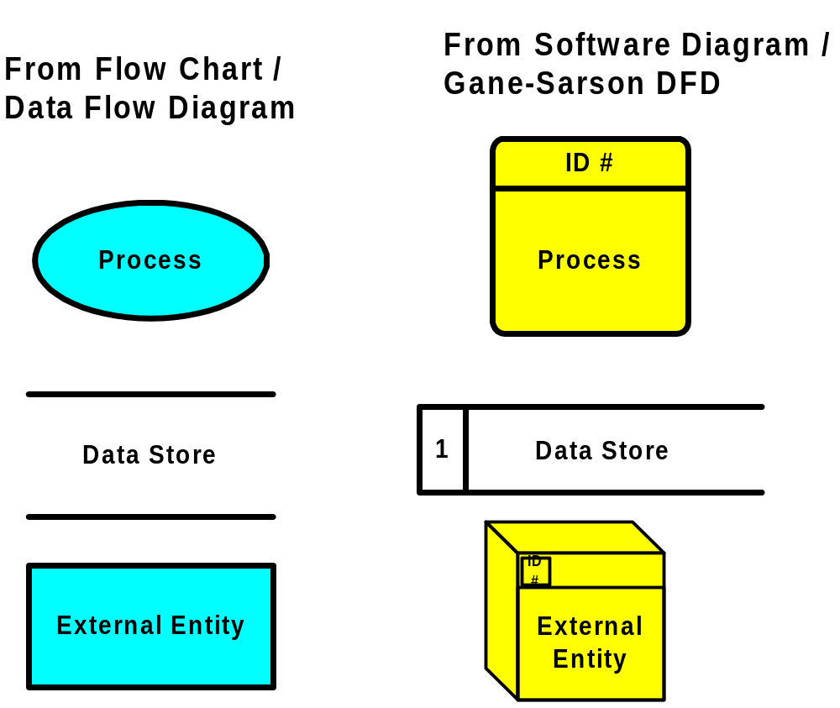
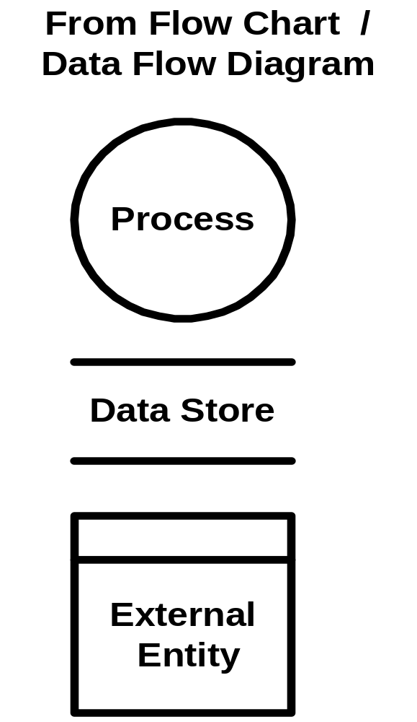
DFD Shapes from Visio
Visio 5.x
Visio 2000

Slide 30
How is Structured Analysis Performed?
Initially represent the software at the most abstract level:
  Called the context diagram.
  The entire system is represented as a single bubble,
  This bubble is labelled according to the main function of the system.

Slide 31
Tic-tac-toe: Context Diagram
Tic-tac-toe software
display
move
Human Player

Slide 32
Context Diagram
A context diagram shows:
  External entities.
  Data input to the system by them,
  Output data generated by the system.
The context diagram is also called the level 0 DFD.

Slide 33
Context Diagram
Establishes the context of the system, i.e.
  Represents
    Data sources
    Data sinks.

Slide 34
Level 1 DFD Construction
game
Display-board
0.1
move
Examine the SRS document:
  Represent each high-level function as a bubble.
  Represent data input to every high-level function.
  Represent data output from every high-level function.
result
Validate-move
0.2
Check-winner
0.4
board
Play-move
0.3

Slide 35
Higher Level DFDs
Each high-level function is separately decomposed into subfunctions:
  Identify the subfunctions of the function
  Identify the data input to each subfunction
  Identify the data output from each subfunction
These are represented as DFDs.

Slide 36
Decomposition
Decomposition of a bubble:
  Also called factoring or exploding.
Each bubble is decomposed into
  Between 3 to 7 bubbles.

Slide 37
Decomposition
Too few bubbles make decomposition superfluous:
  If a bubble is decomposed to just one or two bubbles:
    Then this decomposition is redundant.

Slide 38
Decomposition
Too many bubbles:
  More than 7 bubbles at any level of a DFD.
  Make the DFD model hard to understand.

Slide 39
Decompose How Long?
Decomposition of a bubble should be carried on until:
  A level at which the function of the bubble can be described using a simple algorithm.

Slide 40
Example 1: RMS Calculating Software
Consider a software called RMS calculating software:
  Reads three integers in the range of -1000 and +1000
  Finds out the root mean square (rms) of the three input numbers
  Displays the result.

Slide 41
Example 1: RMS Calculating Software
The context diagram is simple to develop:
  The system accepts 3 integers from the user
  Returns the result to him.

Slide 42
Example 1: RMS Calculating Software
Data-items
Compute- RMS
0
User
result
Context Diagram

Slide 43
Example 1: RMS Calculating Software
From a cursory analysis of the problem description:
  We can see that the system needs to perform several things.

Slide 44
Example 1: RMS Calculating Software
Accept input numbers from the user:
  Validate the numbers,
  Calculate the root mean square of the input numbers
  Display the result.

Slide 45
Example 1: RMS Calculating Software
numbers
Read-numbers
0.1
Validate-numbers
0.2
Valid -numbers
Data-items
error
Display
0.4
Compute-rms
0.3
result
RMS

Slide 46
Example 1: RMS Calculating Software
Squared-sum
Calculate-squared-sum
0.3.1
Calculate-mean
0.3.2
Valid -numbers
Mean-square
Calculate-root
0.3.3
RMS

Slide 47
Example: RMS Calculating Software
b
a
c
Square
0.3.1.1
Square
0.3.1.2
Square
0.3.1.3
bsq
asq
csq
Sum
0.3.1.4
Squared-sum

Slide 48
Example: RMS Calculating Software
Decomposition is never carried on up to basic instruction level:
  A bubble is not decomposed any further:
    If it can be represented by a simple set of instructions.

Slide 49
Data Dictionary
A DFD is always accompanied by a data dictionary.
A data dictionary lists all data items appearing in a DFD:
  Definition of all composite data items in terms of their component data items.
  All data names along with the purpose of the data items.
For example, a data dictionary entry may be:
  grossPay = regularPay+overtimePay

Slide 50
Importance of Data Dictionary
Provides all engineers in a project with standard terminology for all data:
  A consistent vocabulary for data is very important
  Different engineers tend to use different terms to refer to the same data,
    Causes unnecessary confusion.

Slide 51
Importance of Data Dictionary
Data dictionary provides the definition of different data:
  In terms of their component elements.
For large systems,
  The data dictionary grows rapidly in size and complexity.
  Typical projects can have thousands of data dictionary entries.
  It is extremely difficult to maintain such a dictionary manually.

Slide 52
Data Dictionary
CASE (Computer Aided Software Engineering) tools come handy:
  CASE tools capture the data items appearing in a DFD automatically to generate the data dictionary.

Slide 53
Data Dictionary
CASE tools support queries:
  About definition and usage of data items.
For example, queries may be made to find:
  Which data item affects which processes,
  A process affects which data items,
  The definition and usage of specific data items, etc.
Query handling is facilitated:
  If data dictionary is stored in a relational database management system (RDBMS).

Slide 54
Data Definition
Composite data are defined in terms of primitive data items using following operators:
+: denotes composition of data items, e.g
  a+b represents data a and b.
[,,,]: represents selection,
  i.e. any one of the data items listed inside the square bracket can occur.
  For example, [a,b] represents either a occurs or b occurs.

Slide 55
Data Definition
( ): contents inside the bracket represent optional data
  which may or may not appear.
  a+(b) represents either a or a+b occurs.
{}: represents iterative data definition,
  e.g. {name}5 represents five name data.

Slide 56
Data Definition
{name}* represents
  zero or more instances of name data.
= represents equivalence,
  e.g. a=b+c means that a represents b and c.
* *: Anything appearing within * * is considered as comment.

Slide 57
Data Dictionary for RMS Software
numbers=valid-numbers=a+b+c
a:integer * input number *
b:integer * input number *
c:integer * input number *
asq:integer
bsq:integer
csq:integer
squared-sum: integer
Result=[RMS,error]
RMS: integer * root mean square value*
error:string * error message*

Slide 58
Balancing a DFD
Data flowing into or out of a bubble:
  Must match the data flows at the next level of DFD.
In the level 1 of the DFD,
  Data item c flows into the bubble P3 and the data item d and e flow out.
In the next level, bubble P3 is decomposed.
  The decomposition is balanced as data item c flows into the level 2 diagram and d and e flow out.

Slide 59
Balancing a DFD
c
b
c
c1
d1
a
d
e
Level 1
d
e1
e
Level 2

Slide 60
Numbering of Bubbles
Number the bubbles in a DFD:
  Numbers help in uniquely identifying any bubble from its bubble number.
The bubble at context level:
  Assigned number 0.
Bubbles at level 1:
  Numbered 0.1, 0.2, 0.3, etc
When a bubble numbered x is decomposed,
  Its children bubble are numbered x.1, x.2, x.3, etc.

Slide 61
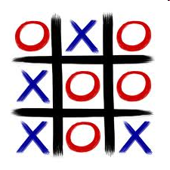
Example 2: Tic-Tac-Toe Computer Game
A human player and the computer make alternate moves on a 3 X 3 square.
A move consists of marking a previously unmarked square.
The user inputs a number between 1 and 9 to mark a square
Whoever is first to place three consecutive marks along a straight line (i.e., along a row, column, or diagonal) on the square wins.

Slide 62
Example: Tic-Tac-Toe Computer Game
As soon as either of the human player or the computer wins,
  A message announcing the winner should be displayed.
If neither player manages to get three consecutive marks along a straight line,
  And all the squares on the board are filled up,
  Then the game is drawn.
The computer always tries to win a game.

Slide 63
Context Diagram for Example
Tic-tac-toe software
0
display
move
Human Player

Slide 64
Level 1 DFD
game
Display-board
0.1
move
result
Validate-move
0.2
Check-winner
0.4
board
Play-move
0.3

Slide 65
Data Dictionary
Display=game + result
move = integer
board = {integer}9
game = {integer}9
result=string

Slide 66
Example 3: Trading-House Automation System (TAS)
A large trading house wants us to develop a software:
  To automate book keeping activities associated with its business.
It has many regular customers:
  Who place orders for various kinds of commodities.

Slide 67
Example 3: Trading-House Automation System (TAS)
The trading house maintains names and addresses of its regular customers.
Each customer is assigned a unique customer identification number (CIN).
As per current practice when a customer places order:
  The accounts department first checks the credit-worthiness of the customer.

Slide 68
Example: Trading-House Automation System (TAS)
The credit worthiness of a customer is determined:
  By analyzing the history of his payments to the bills sent to him in the past.
If a customer is not credit-worthy:
  His orders are not processed any further
  An appropriate order rejection message is generated for the customer.

Slide 69
Example: Trading-House Automation System (TAS)
If a customer is credit-worthy:
  Items he/she has ordered are checked against the list of items the trading house deals with.
The items that the trading house does not deal with:
  Are not processed any further
  An appropriate message for the customer for these items is generated.

Slide 70
Example: Trading-House Automation System (TAS)
The items in a customer's order that the trading house deals with:
  Are checked for availability in inventory.
If the items are available in the inventory in desired quantities:
  A bill with the forwarding address of the customer is printed.
  A material issue slip is printed.

Slide 71
Example: Trading-House Automation System (TAS)
The customer can produce the material issue slip at the store house:
  Take delivery of the items.
  Inventory data adjusted to reflect the sale to the customer.

Slide 72
Example: Trading-House Automation System (TAS)
If an ordered item is not available in the inventory in sufficient quantity:
  To be able to fullfill pending orders store details in a "pending-order" file :
    out-of-stock items along with quantity ordered.
    customer identification number

Slide 73
Example: Trading-House Automation System (TAS)
The purchase department:
  would periodically issue commands to generate indents.
When generate indents command is issued:
  The system should examine the "pending-order" file
  Determine the orders that are pending
  Total quantity required for each of the items.

Slide 74
Example: Trading-House Automation System (TAS)
TAS should find out the addresses of the vendors who supply the required items:
  Examine the file containing vendor details (their address, items they supply etc.)
  Print out indents to those vendors.

Slide 75
Example: Trading-House Automation System (TAS)
TAS should also answers managerial queries:
  Statistics of different items sold over any given period of time
  Corresponding quantity sold and the price realized.

Slide 76
Context Diagram
indent
query
Trading-House-Automation-System
0
Manager
statistics
order
Generate-indent
response
Customer
Purchase-Department

Slide 77
Level 1 DFD
Customer-history
Item-file
query
Accept-order
0.1
inventory
statistics
Customer-file
Handle-query
0.3
order
Process-order
0.2
Accepted-orders
Vendor-list
Handle-indent-request
0.4
Indent-request
Sales-statistics
Indents
Material-issue-slip + bill
pending-order

Slide 78
Example: Data Dictionary
response: [bill + material-issue-slip, reject-message]
query: period /* query from manager regarding sales statistics*/
period: [date+date,month,year,day]
date: year + month + day
year: integer
month: integer
day: integer
order: customer-id + {items + quantity}*
accepted-order: order /* ordered items available in inventory */
reject-message: order + message /* rejection message */
pending-orders: customer-id + {items+quantity}*
customer-address: name+house#+street#+city+pin

Slide 79
Example: Data Dictionary
item-name: string
house#: string
street#: string
city: string
pin: integer
customer-id: integer
bill: {item + quantity + price}* + total-amount + customer-address
material-issue-slip: message + item + quantity + customer-address
message: string
statistics: {item + quantity + price }*
sales-statistics: {statistics}*
quantity: integer

Slide 80
Observation
From the examples,
  Observe that DFDs help create:
    Data model
    Function model

Slide 81
Observation
As a DFD is refined into greater levels of detail:
  The analyst performs an implicit functional decomposition.
  At the same time, refinements of data takes place.

Slide 82
Guidelines For Constructing DFDs
Context diagram should represent the system as a single bubble:
  Many beginners commit the mistake of drawing more than one bubble in the context diagram.

Slide 83
Guidelines For Constructing DFDs
All external entities should be represented in the context diagram:
  External entities should not appear at any other level of DFD.
Only 3 to 7 bubbles per diagram should be allowed:
  Each bubble should be decomposed to between 3 and 7 bubbles.

Slide 84
Guidelines For Constructing DFDs
A common mistake committed by many beginners:
  Attempting to represent control information in a DFD.
  e.g. trying to represent the order in which different functions are executed.

Slide 85
Guidelines For Constructing DFDs
A DFD model does not represent control information:
  When or in what order different functions (processes) are invoked
  The conditions under which different functions are invoked are not represented.
  For example, a function might invoke one function or another depending on some condition.
  Many beginners try to represent this aspect by drawing an arrow between the corresponding bubbles.

Slide 86
Find Error Example-1
Functionality: Check the input value:
  If the input value is less than -1000 or greater than +1000 generate an error message
  otherwise search for the number
Generate
Error
Check
number
message
number
number
Search
[found,not-found]

Slide 87
Find 4 Errors
item
query
inventory
statistics
Item-file
Handle-query
0.3
Process-order
0.2
statistics
Handle-indent-request
0.4
Sales-statistics
Material-issue-slip + bill
pending-order

Slide 88
Common Mistakes in Constructing DFDs
If a bubble A invokes either bubble B or bubble C depending on some conditions:
  Represent the data that flows from bubble A to bubble B and bubbles A to C
  Not the conditions depending on which a process is invoked.

Slide 89
Find Error Example-2
A function accepts the book name to be searched from the user
If the entered book name is not a valid book name
  Generates an error message,
If the book name is valid,
  Searches the book name in database.
Search-book
Get-book-name
Good-book-name
Book-details
Print-err-message
Error-message
Book-name

Slide 90
Guidelines For Constructing DFDs
All functions of the system must be captured in the DFD model:
  No function specified in the SRS document should be overlooked.
Only those functions specified in the SRS document should be represented:
  Do not assume extra functionality of the system not specified by the SRS document.

Slide 91
Commonly Made Errors
Unbalanced DFDs
Forgetting to name the data flows
Unrepresented functions or data
External entities appearing at higher level DFDs
Trying to represent control aspects
Context diagram having more than one bubble
A bubble decomposed into too many bubbles in the next level
Terminating decomposition too early
Nouns used in naming bubbles

Slide 92
Shortcomings of the DFD Model
DFD models suffer from several shortcomings:
DFDs leave ample scope to be imprecise.
  In a DFD model, we infer about the function performed by a bubble from its label.
  A label may not capture all the functionality of a bubble.

Slide 93
Shortcomings of the DFD Model
For example, a bubble named find-book-position has only intuitive meaning:
  Does not specify several things:
    What happens when some input information is missing or is incorrect.
    Does not convey anything regarding what happens when book is not found
    or what happens if there are books by different authors with the same book title.

Slide 94
Shortcomings of the DFD Model
Control information is not represented:
  For instance, order in which inputs are consumed and outputs are produced is not specified.
Customer-history
Item-file
inventory
Customer-file
Accept-order
order
Process-order
Accepted-orders

Slide 95
Shortcomings of the DFD Technique
A DFD does not specify synchronization aspects:
  For instance, the DFD in TAS example does not specify:
    Whether process-order may wait until the accept-order produces data
    Whether accept-order and handle-order may proceed simultaneously with some buffering mechanism between them.

Slide 96
Shortcomings of the DFD Model
Decomposition is carried out to arrive at the successive levels of a DFD is subjective.
The ultimate level to which decomposition is carried out is subjective:
  Depends on the judgement of the analyst.
Even for the same problem,
  Several alternative DFD representations are possible:
  Many times it is not possible to say which DFD representation is superior or preferable.

Slide 97
Shortcomings of the DFD Model
DFD technique does not provide:
  Any clear guidance as to how exactly one should go about decomposing a function:
  One has to use subjective judgement to carry out decomposition.
Structured analysis techniques do not specify when to stop a decomposition process:
  To what length decomposition needs to be carried out.

Slide 98
DFD Tools
Several commercial and free tools available.
Commercial:
  Visio
  Smartdraw (30 day free trial)
  Edraw
  Creately
  Visual analyst
Free:
  Dia (GNU open source)

Slide 99
Word of Caution
Tools can be easily learned and used.
Too much focus on SA/SD case tools does not make you any more a good designer:
  Than an expert knowledge of the Word Package making you a famous writer of thriller stories.

Slide 100
Structured Design
The aim of structured design
  Transform the results of structured analysis (DFD representation) into a structure chart.
A structure chart represents the software architecture:
  Various modules making up the system,
  Module dependency (i.e. which module calls which other modules),
  Parameters passed among different modules.

Slide 101
Structure Chart
Structure chart representation
  Easily implementable using programming languages.
Main focus of a structure chart:
  Define the module structure of a software,
  Interaction among different modules,
  Procedural aspects (e.g, how a particular functionality is achieved) are not represented.

Slide 102
Basic Building Blocks of Structure Chart
Rectangular box:
  A rectangular box represents a module.
  Annotated with the name of the module it represents.
Process-order

Slide 103
Arrows
An arrow between two modules implies:
  During execution control is passed from one module to the other in the direction of the arrow.
root
Process-order
Handle-indent
Handle-query

Slide 104
Data Flow Arrows
Data flow arrows represent:
  Data passing from one module to another in the direction of the arrow.
root
order
Process-order

Slide 105

Library Modules
Library modules represent frequently called modules:
  A rectangle with double side edges.
  Simplifies drawing when a module is called by several modules.

Slide 106
Selection
The diamond symbol represents:
  One module of several modules connected to the diamond symbol is invoked depending on some condition.
root
Process-order
Handle-indent
Handle-query

Slide 107
Repetition
A loop around control flow arrows denotes that the concerned modules are invoked repeatedly.
root
Process-order
Handle-indent
Handle-query

Slide 108
Structure Chart
There is only one module at the top:
  the root module.
There is at most one control relationship between any two modules:
  if module A invokes module B,
  Module B cannot invoke module A.
The main reason behind this restriction:
  Modules in a structure chart should be arranged in layers or levels.

Slide 109
Structure Chart
The principle of abstraction:
  does not allow lower-level modules to invoke higher-level modules:
  But, two higher-level modules can invoke the same lower-level module.

Slide 110
Example
root
rms
rms
Valid-numbers
Valid-numbers
Get-good-data
Compute-solution
Display-solution
Get-data
Validate-
data

Slide 111
Bad Design

Slide 112
Shortcomings of Structure Chart
By looking at a structure chart:
  we can not say whether a module calls another module just once or many times.
Also, by looking at a structure chart:
  we can not tell the order in which the different modules are invoked.

Slide 113
Flow Chart (Aside)
We are all familiar with the flow chart representations:
  Flow chart is a convenient technique to represent the flow of control in a system.
A=B
if(c == 100)
P=20
else p= 80
while(p>20)
print(student mark)
A=B
yes
no
P=20
P=80
dummy
yes
no
Print

Slide 114
Flow Chart versus Structure Chart
A structure chart differs from a flow chart in three principal ways:
  It is difficult to identify modules of a software from its flow chart representation.
  Data interchange among the modules is not represented in a flow chart.
  Sequential ordering of tasks inherent in a flow chart is suppressed in a structure chart.

Slide 115
Transformation of a DFD Model into Structure Chart
Two strategies exist to guide transformation of a DFD into a structure chart:
  Transform Analysis
  Transaction Analysis

Slide 116
Transform Analysis
The first step in transform analysis:
  Divide the DFD into 3 parts:
    input,
    logical processing,
    output.

Slide 117
Transform Analysis
Input portion in the DFD:
  processes which convert input data from physical to logical form.
  e.g. read characters from the terminal and store in internal tables or lists.
Each input portion:
  called an afferent branch.
  Possible to have more than one afferent branch in a DFD.

Slide 118
Transform Analysis
Output portion of a DFD:
  transforms output data from logical form to physical form.
    e.g., from list or array into output characters.
  Each output portion:
    called an efferent branch.
The remaining portions of a DFD
  called central transform

Slide 119
Transform Analysis
Derive structure chart by drawing one functional component for:
  the central transform,
  each afferent branch,
  each efferent branch.

Slide 120
Transform Analysis
Identifying the highest level input and output transforms:
  requires experience and skill.
Some guidelines:
  Trace inputs until a bubble is found whose output cannot be deduced from the inputs alone.
  Processes which validate input are not central transforms.
  Processes which sort input or filter data from it are.

Slide 121
Transform Analysis
First level of structure chart:
  Draw a box for each input and output units
  A box for the central transform.
Next, refine the structure chart:
  Add subfunctions required by each high-level module.
  Many levels of modules may required to be added.

Slide 122
Factoring
The process of breaking functional components into subcomponents.
Factoring includes adding:
  Read and write modules,
  Error-handling modules,
  Initialization and termination modules,etc.
Finally check:
  Whether all bubbles have been mapped to modules.

Slide 123
Example 1: RMS Calculating Software
Data-items
Compute- RMS
0
User
result
Context Diagram

Slide 124
Example 1: RMS Calculating Software
From a cursory analysis of the problem description,
  easy to see that the system needs to perform:
    accept the input numbers from the user,
    validate the numbers,
    calculate the root mean square of the input numbers,
    display the result.

Slide 125
Example 1: RMS Calculating Software
numbers
Read-numbers
0.1
Validate-numbers
0.2
Valid -numbers
Data-items
error
Compute-rms
0.3
Display
0.4
result
RMS

Slide 126
Example 1: RMS Calculating Software
By observing the level 1 DFD:
  Identify read-number and validate-number bubbles as the afferent branch
  Display as the efferent branch.

Slide 127
Example 1: RMS Calculating Software
root
rms
rms
Valid-numbers
Valid-numbers
Get-good-data
Compute-solution
Display-solution
Get-data
Validate-
data

Slide 128
Example 2: Tic-Tac-Toe Computer Game
As soon as either of the human player or the computer wins,
  A message congratulating the winner should be displayed.
If neither player manages to get three consecutive marks along a straight line,
  And all the squares on the board are filled up,
  Then the game is drawn.
The computer always tries to win a game.

Slide 129
Context Diagram for Example 2
Tic-tac-toe software
0
display
move
Human Player

Slide 130
Level 1 DFD
game
Display-board
move
result
Validate-move
Check-winner
board
Play-move

Slide 131
Structure Chart
root
Get-good-move
Compute-game
Display
Get-move
Validate- move
play-move
Check- winner

Slide 132
Transaction Analysis
Useful for designing transaction processing programs.
  Transform-centered systems:
    Characterized by similar processing steps for every data item processed by input, process, and output bubbles.
  Transaction-driven systems,
    One of several possible paths through the DFD is traversed depending upon the input data value.

Slide 133
Transaction Analysis
Transaction:
  Any input data value that triggers an action:
  For example, selected menu options might trigger different functions.
  Represented by a tag identifying its type.
Transaction analysis uses this tag to divide the system into:
  Several transaction modules
  One transaction-center module.

Slide 134
Transaction analysis
Transaction- center
trans 3
trans 1
trans 2
type 1
type 2
type 3

Slide 135
Level 1 DFD for TAS
Customer-history
Item-file
query
Accept-order
inventory
statistics
Customer-file
Handle-query
order
Process-order
Accepted-orders
Vendor-list
Handle-indent-request
Indent-request
Sales-statistics
Indents
pending-order

Slide 136
Structure Chart
root
order
query
indent
Handle-order
Handle-indent
Handle-query
Accept-order
Get-order
Process-order

Slide 137
Summary
We discussed a sample function-oriented software design methodology:
  Structured Analysis/Structured Design(SA/SD)
  Incorporates features from some important design methodologies.
SA/SD consists of two parts:
  Structured analysis
  Structured design.

Slide 138
Summary
The goal of structured analysis:
  functional decomposition of the system.
Results of structured analysis:
  represented using Data Flow Diagrams (DFDs).
We examined why any hierarchical model is easy to understand.
  Number 7 is called the magic number.

Slide 139
Summary
During structured design,
  The DFD representation is transformed to a structure chart representation.
DFDs are very popular:
  Because it is a very simple technique.

Slide 140
Summary
A DFD model:
  Difficult to implement using a programming language:
  Structure chart representation can be easily implemented using a programming language.

Slide 141
Summary
Several CASE tools are available:
  Support structured analysis and design.
  Maintain the data dictionary,
  Check whether DFDs are balanced or not.

